Slide 1
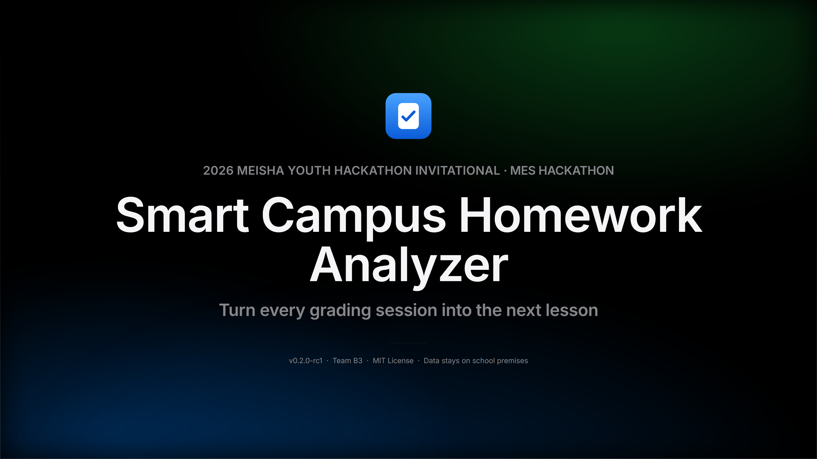
Notes:
Opening ~20 seconds. One sentence to say who we are: Smart Campus Homework Analyzer — turning the daily grading teachers do into a ready-to-teach review lesson plan. Today isn't about 'yet another grading tool' — it's about the information wasted after grading is done.

Slide 2
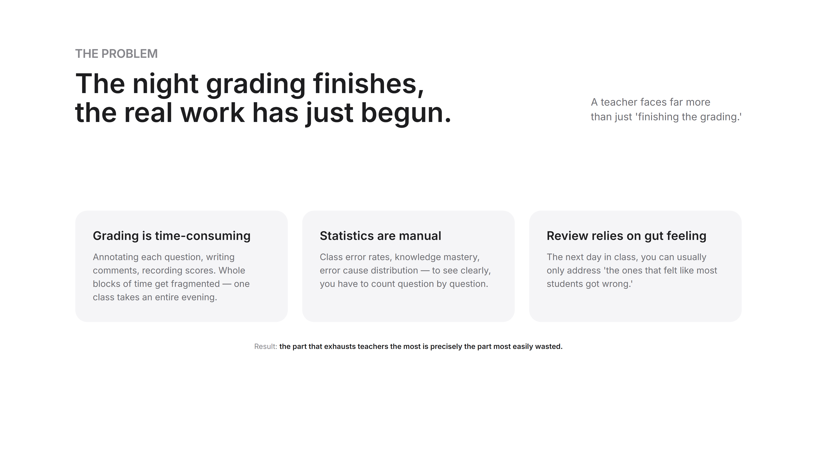
Notes:
The only slide about pain — no drama, just facts. Three things: grading itself is time-consuming, statistics are manual, review relies on gut feeling. The last line is the hook — the part that exhausts teachers the most is precisely the part most easily wasted.

Slide 3
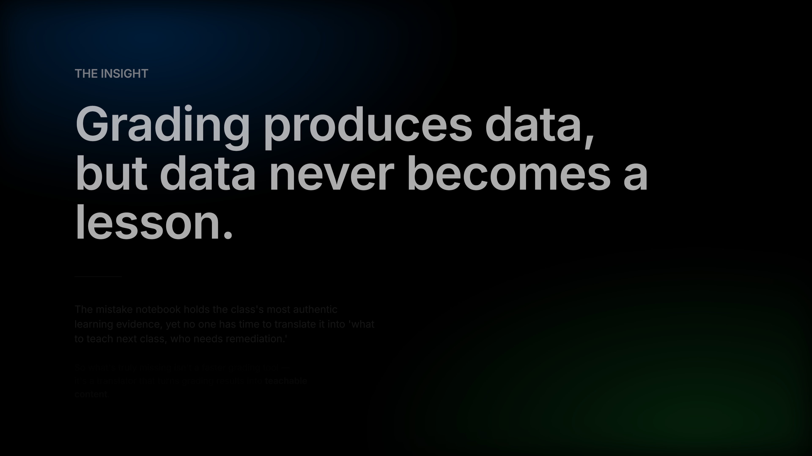
Notes:
The core insight, and the starting point of the entire product. Grading already produces the class's most authentic learning evidence — the problem is no one has time to translate it into 'what to teach next class.' So what we built isn't faster grading — it's that translation layer.

Slide 4
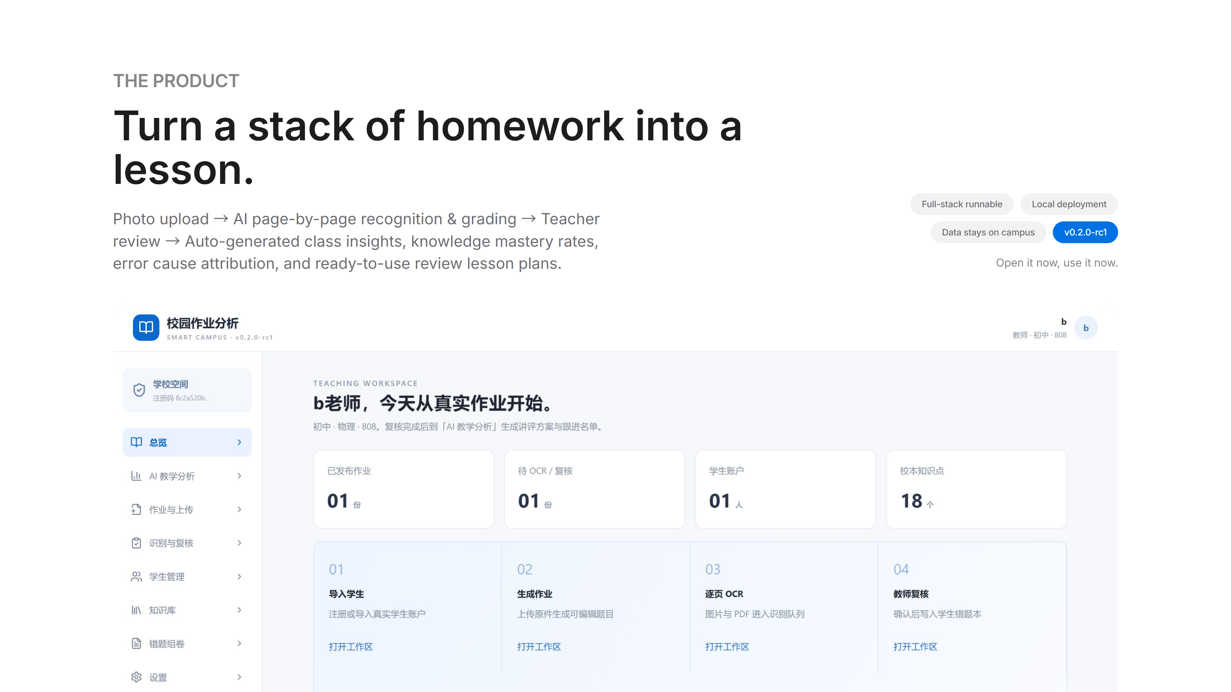
Notes:
Product in one sentence: turn a stack of homework into a lesson. This is the overview screenshot; the flow cards on the right are actually the product's five modules. Worth emphasizing here: this is a fully runnable full-stack product, not a concept mockup — it runs right now.

Slide 5
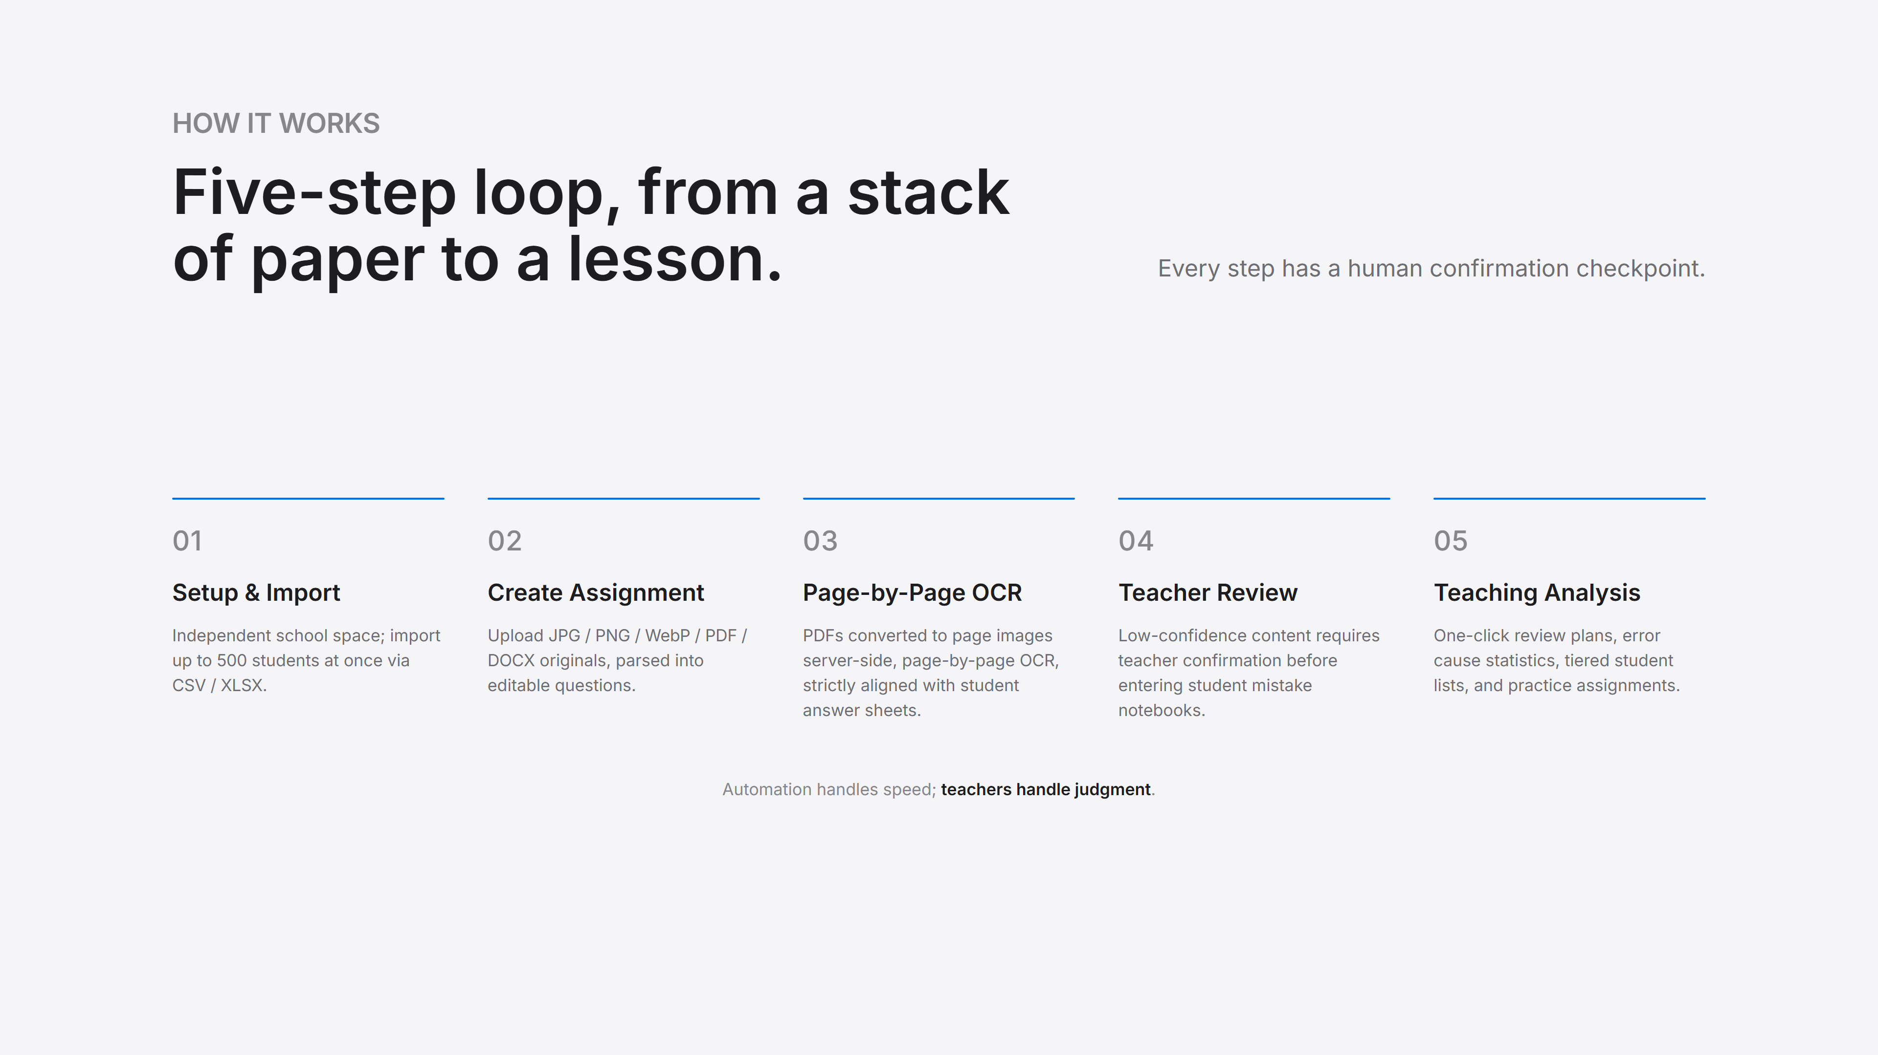
Notes:
Five-step loop. Focus on steps 3 and 4: PDFs are converted to page images server-side — no manual conversion needed by teachers; low-confidence OCR results require teacher confirmation before entering student mistake notebooks — that's our baseline. Only after completing the full flow does step 5 have anything to analyze.

Slide 6
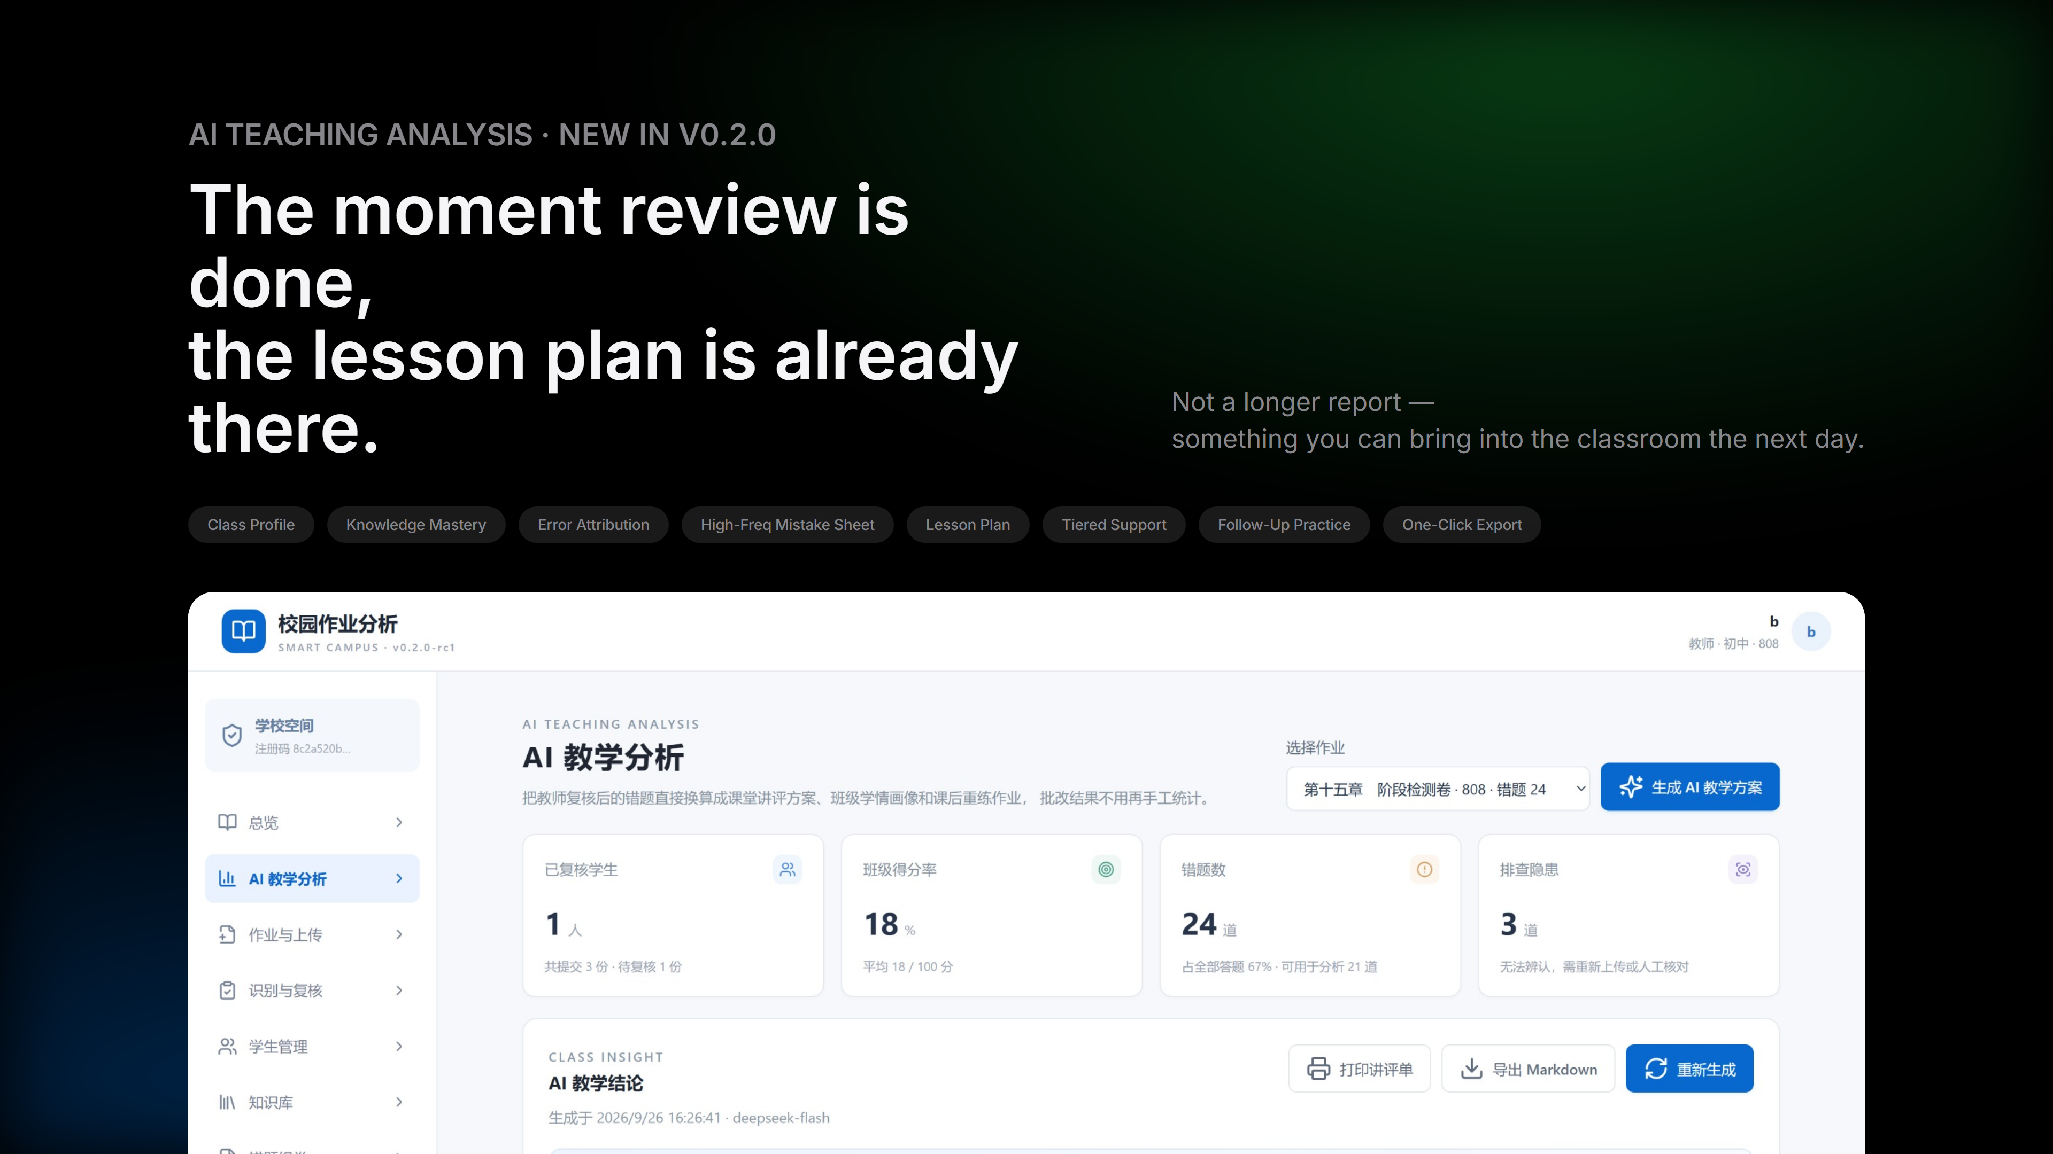
Notes:
This is the core of v0.2.0, and the slide we most want to present today. On the left is raw data: 1 student, 3 submissions, 18 questions, 24 mistakes, scoring rate 18%. On the right is the system's teaching conclusion — notice it says 'points were lost mainly because students didn't attempt rather than didn't know.' That judgment is nearly impossible to reach manually on the same day.

Slide 7
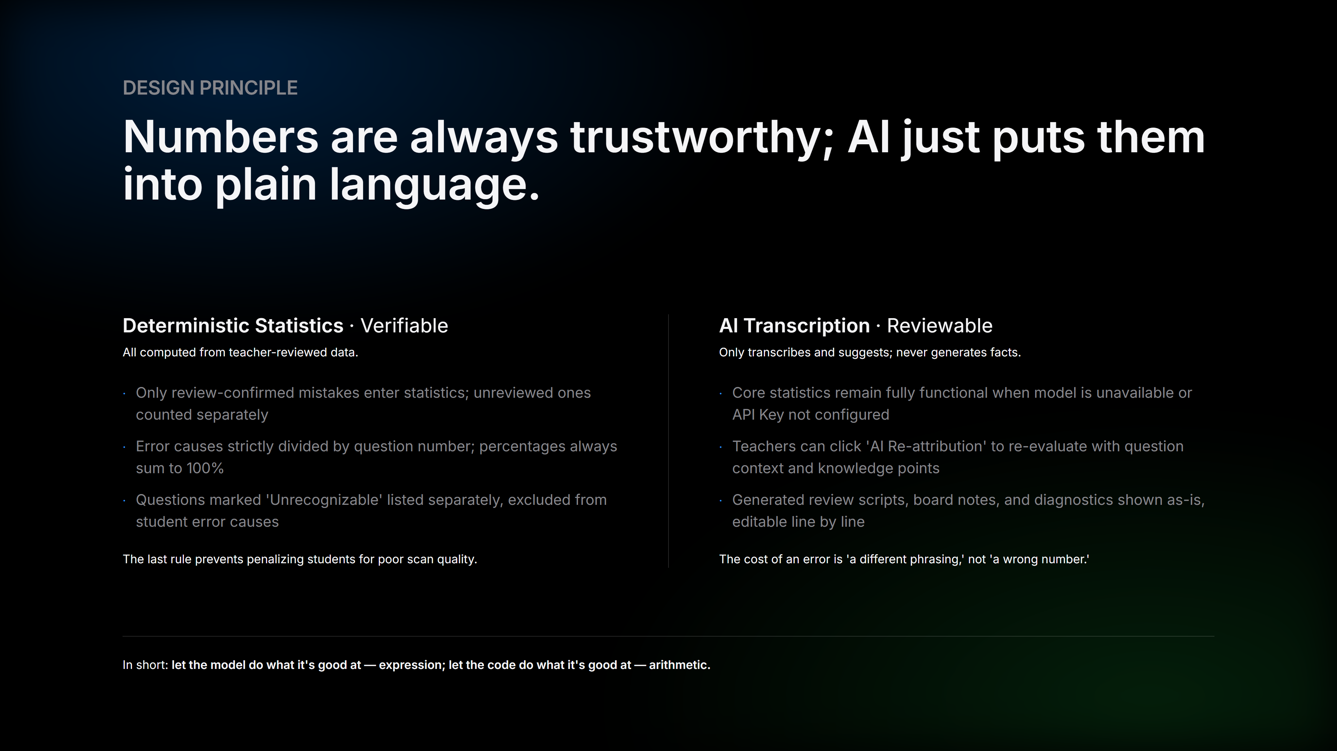
Notes:
This is the slide judges should remember most, and our biggest differentiator. All numbers are deterministically computed from teacher-reviewed data; the model only transcribes them into classroom language. So if the model is down or the API key isn't configured, core statistics remain fully functional. Two more details: error causes are strictly divided by question number, percentages always sum to 100%; questions marked 'Unrecognizable' are listed separately and excluded from student error causes — we never penalize students for poor scan quality.

Slide 8
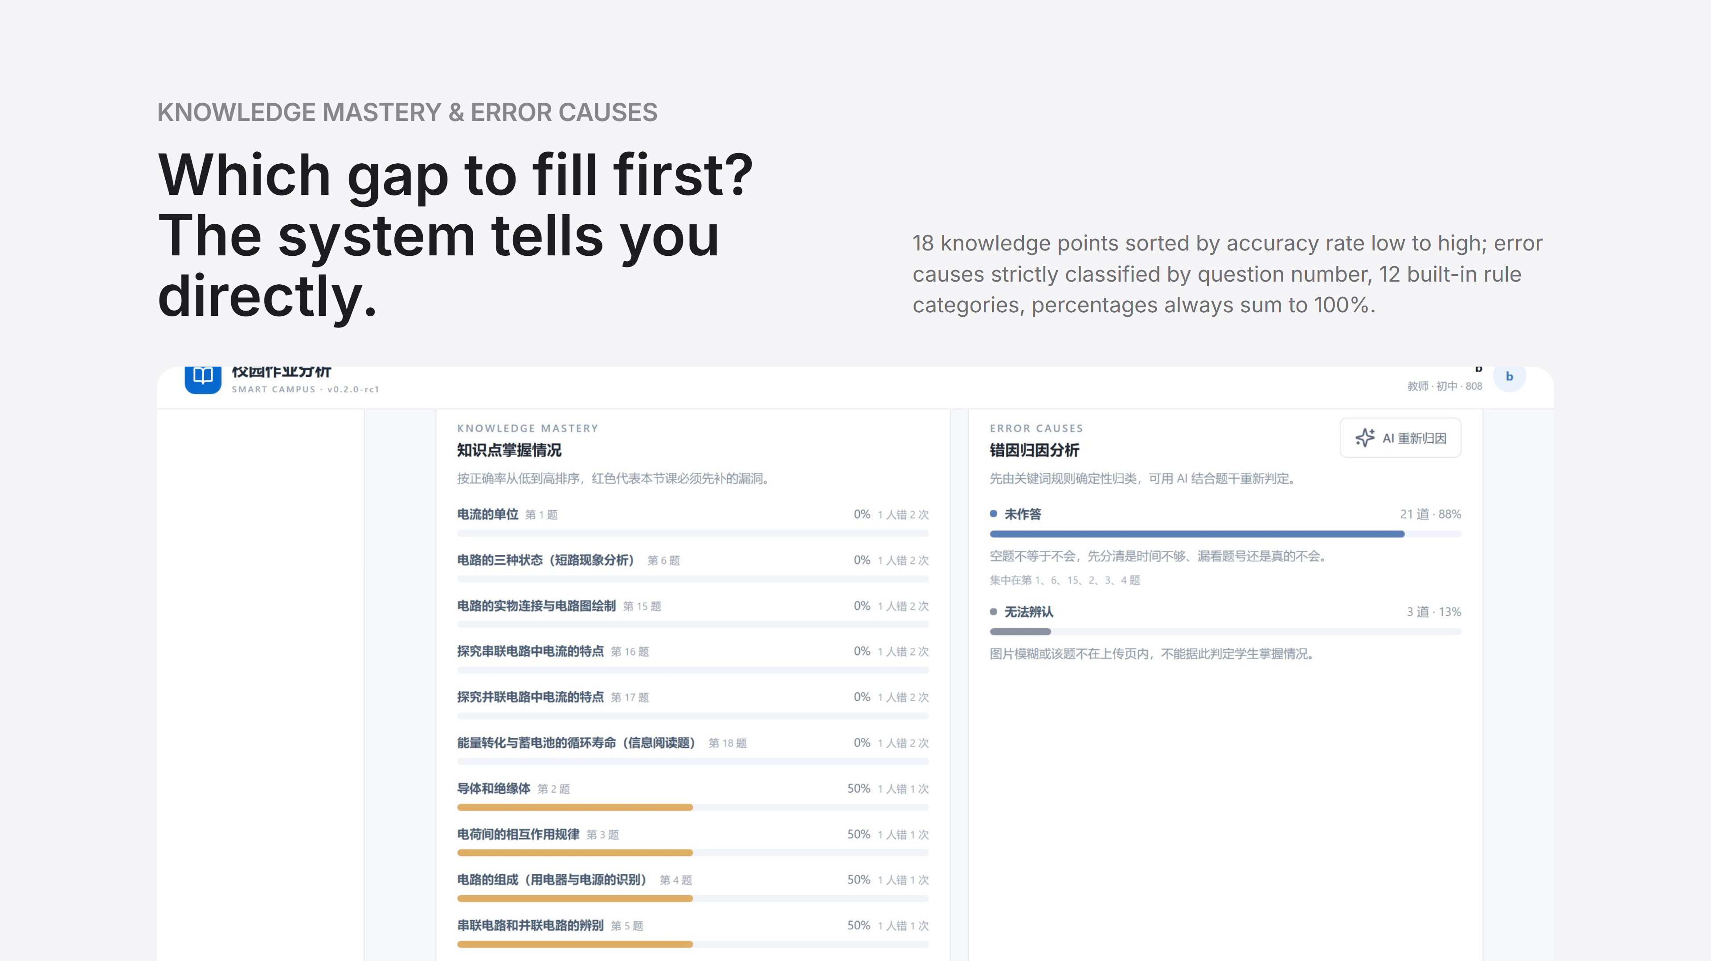
Notes:
Real data screenshot. On the left, knowledge mastery sorted from weakest first — teachers instantly know which gap to fill first in today's lesson. On the right, 12 error cause categories are determined by keyword-based deterministic classification, consuming no model quota; clicking 'AI Re-attribution' invokes the model to re-evaluate with question context.

Slide 9
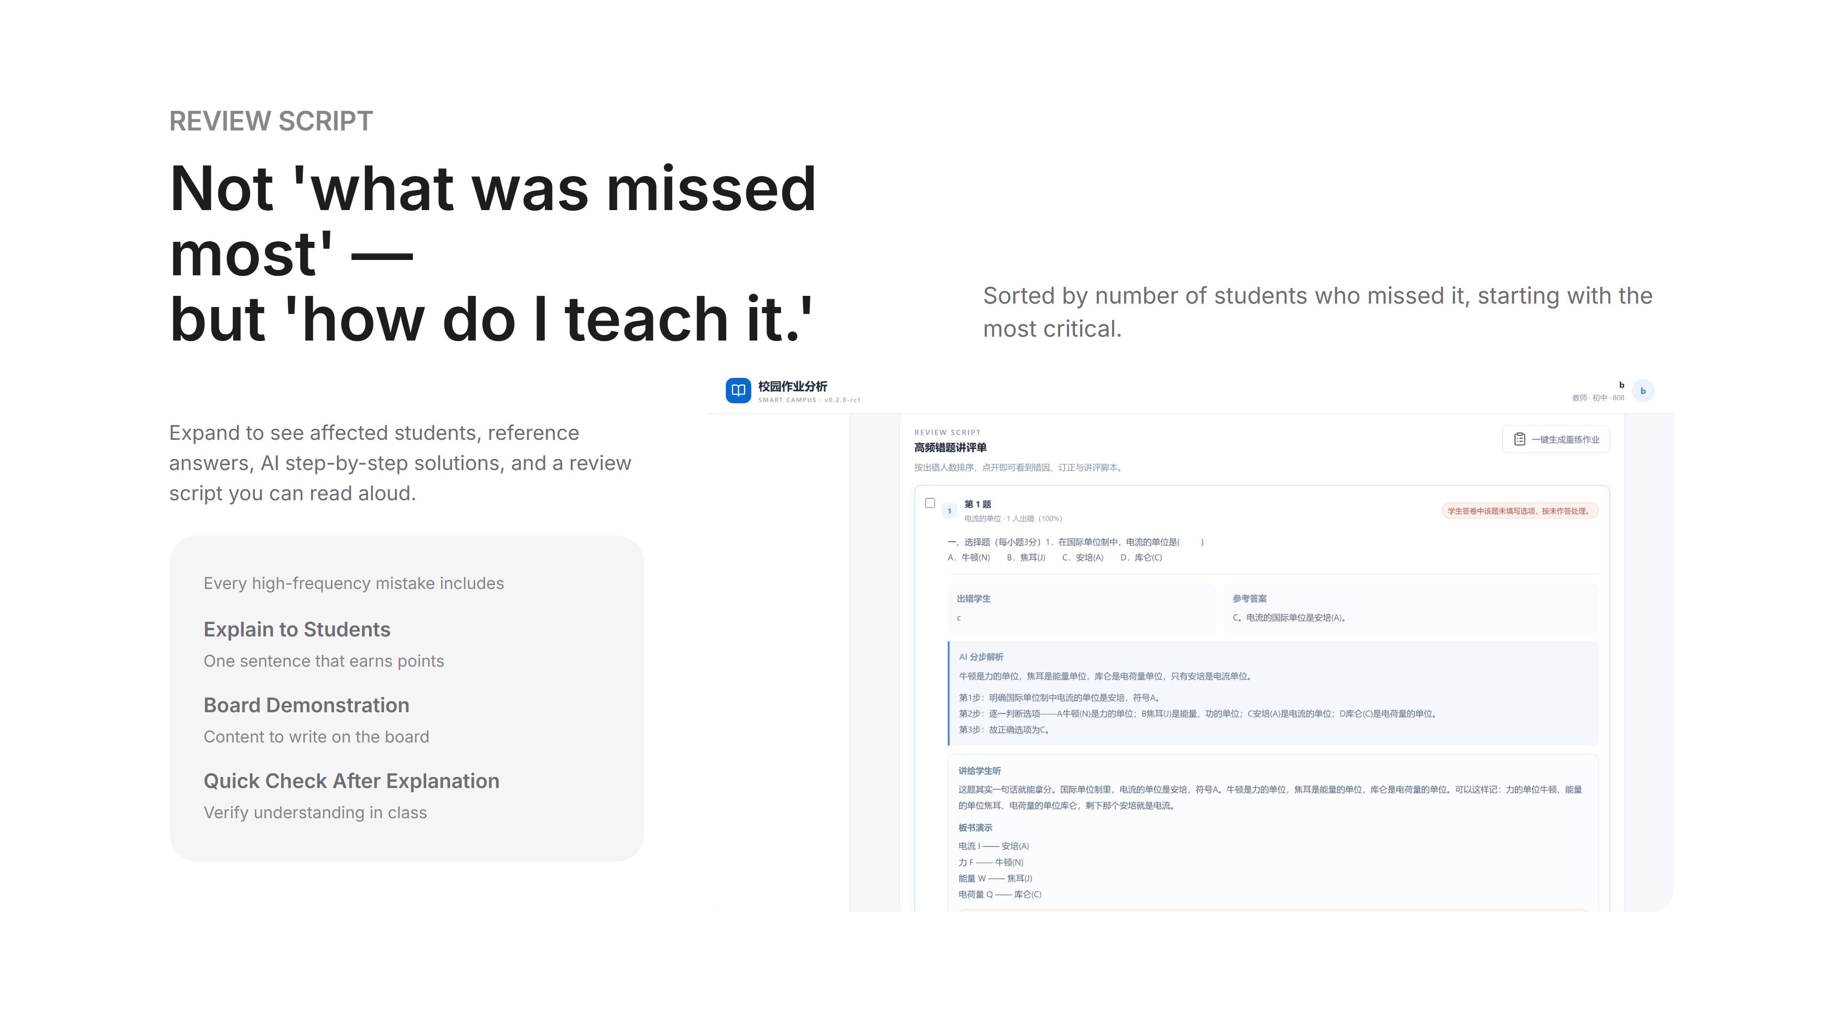
Notes:
This slide proves 'ready to teach.' Expand a high-frequency mistake to see affected students, reference answers, AI step-by-step solutions, and most importantly three sections below: explain to students, board demonstration, quick check after explanation. Teachers can read it aloud the next day. Content sorted by number of students who missed it, starting with the most critical.

Slide 10
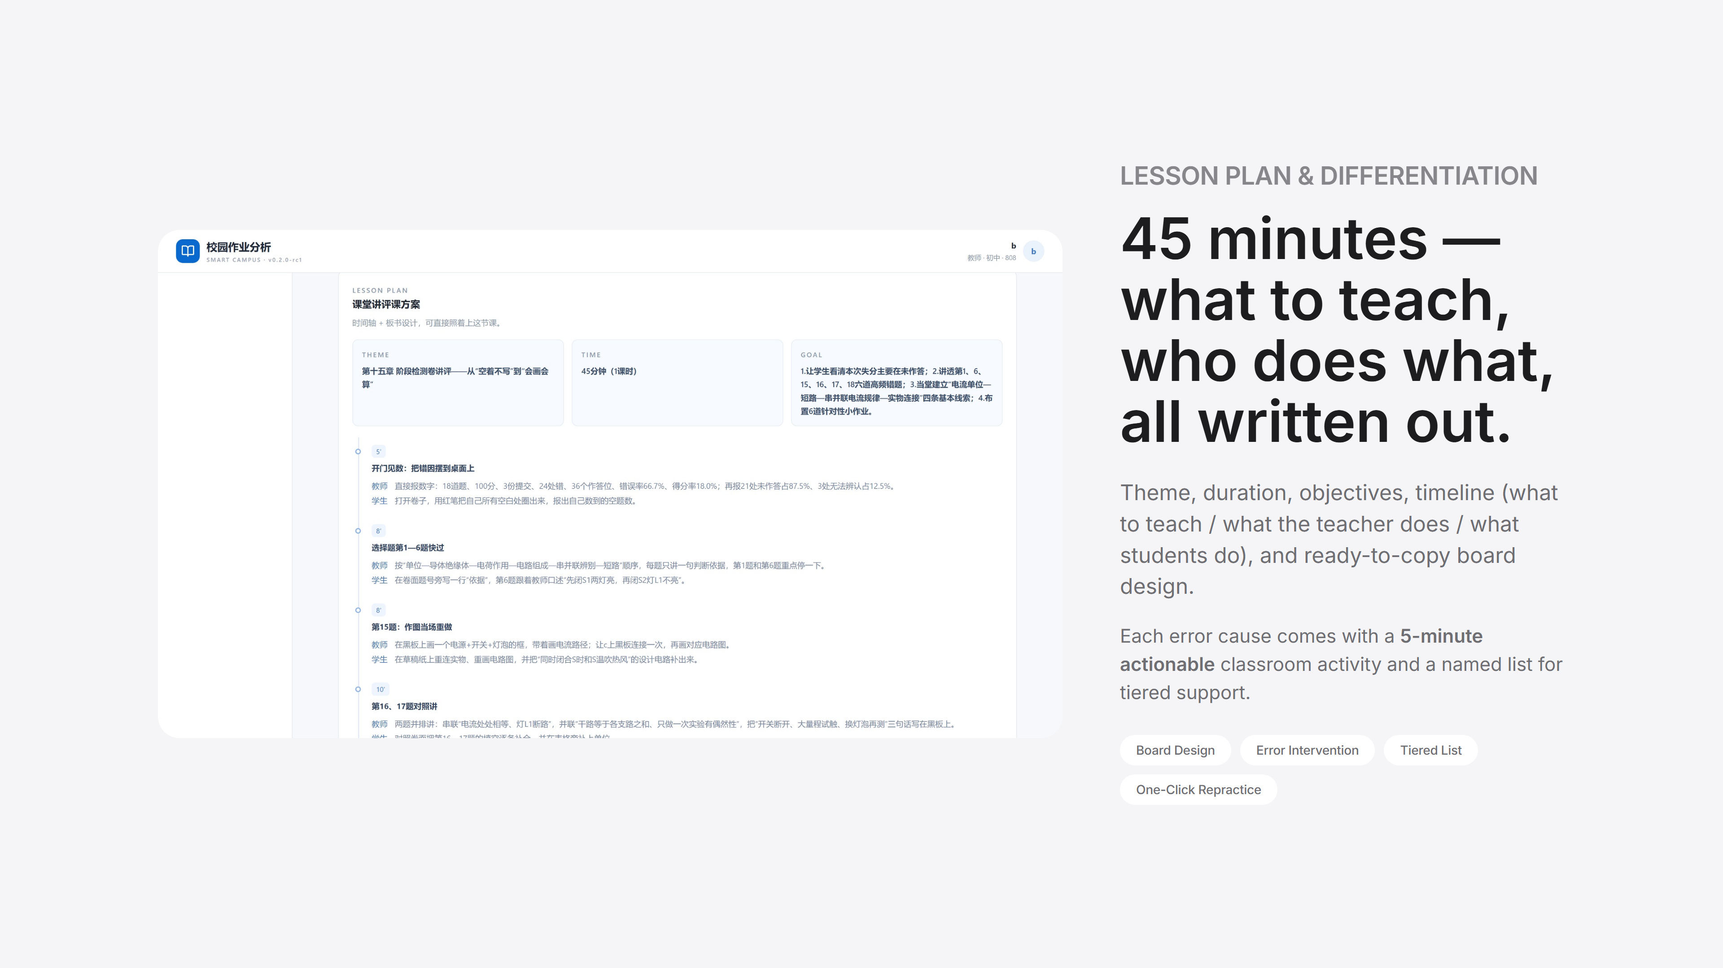
Notes:
This slide brings it into the classroom. 45 minutes broken into a timeline, each step specifying 'what to teach, what the teacher does, what students do,' plus board design; each error cause comes with a 5-minute actionable classroom activity and a named list for tiered support. Our internal saying: this isn't a report for administrators — it's a lesson plan for teachers themselves.

Slide 11
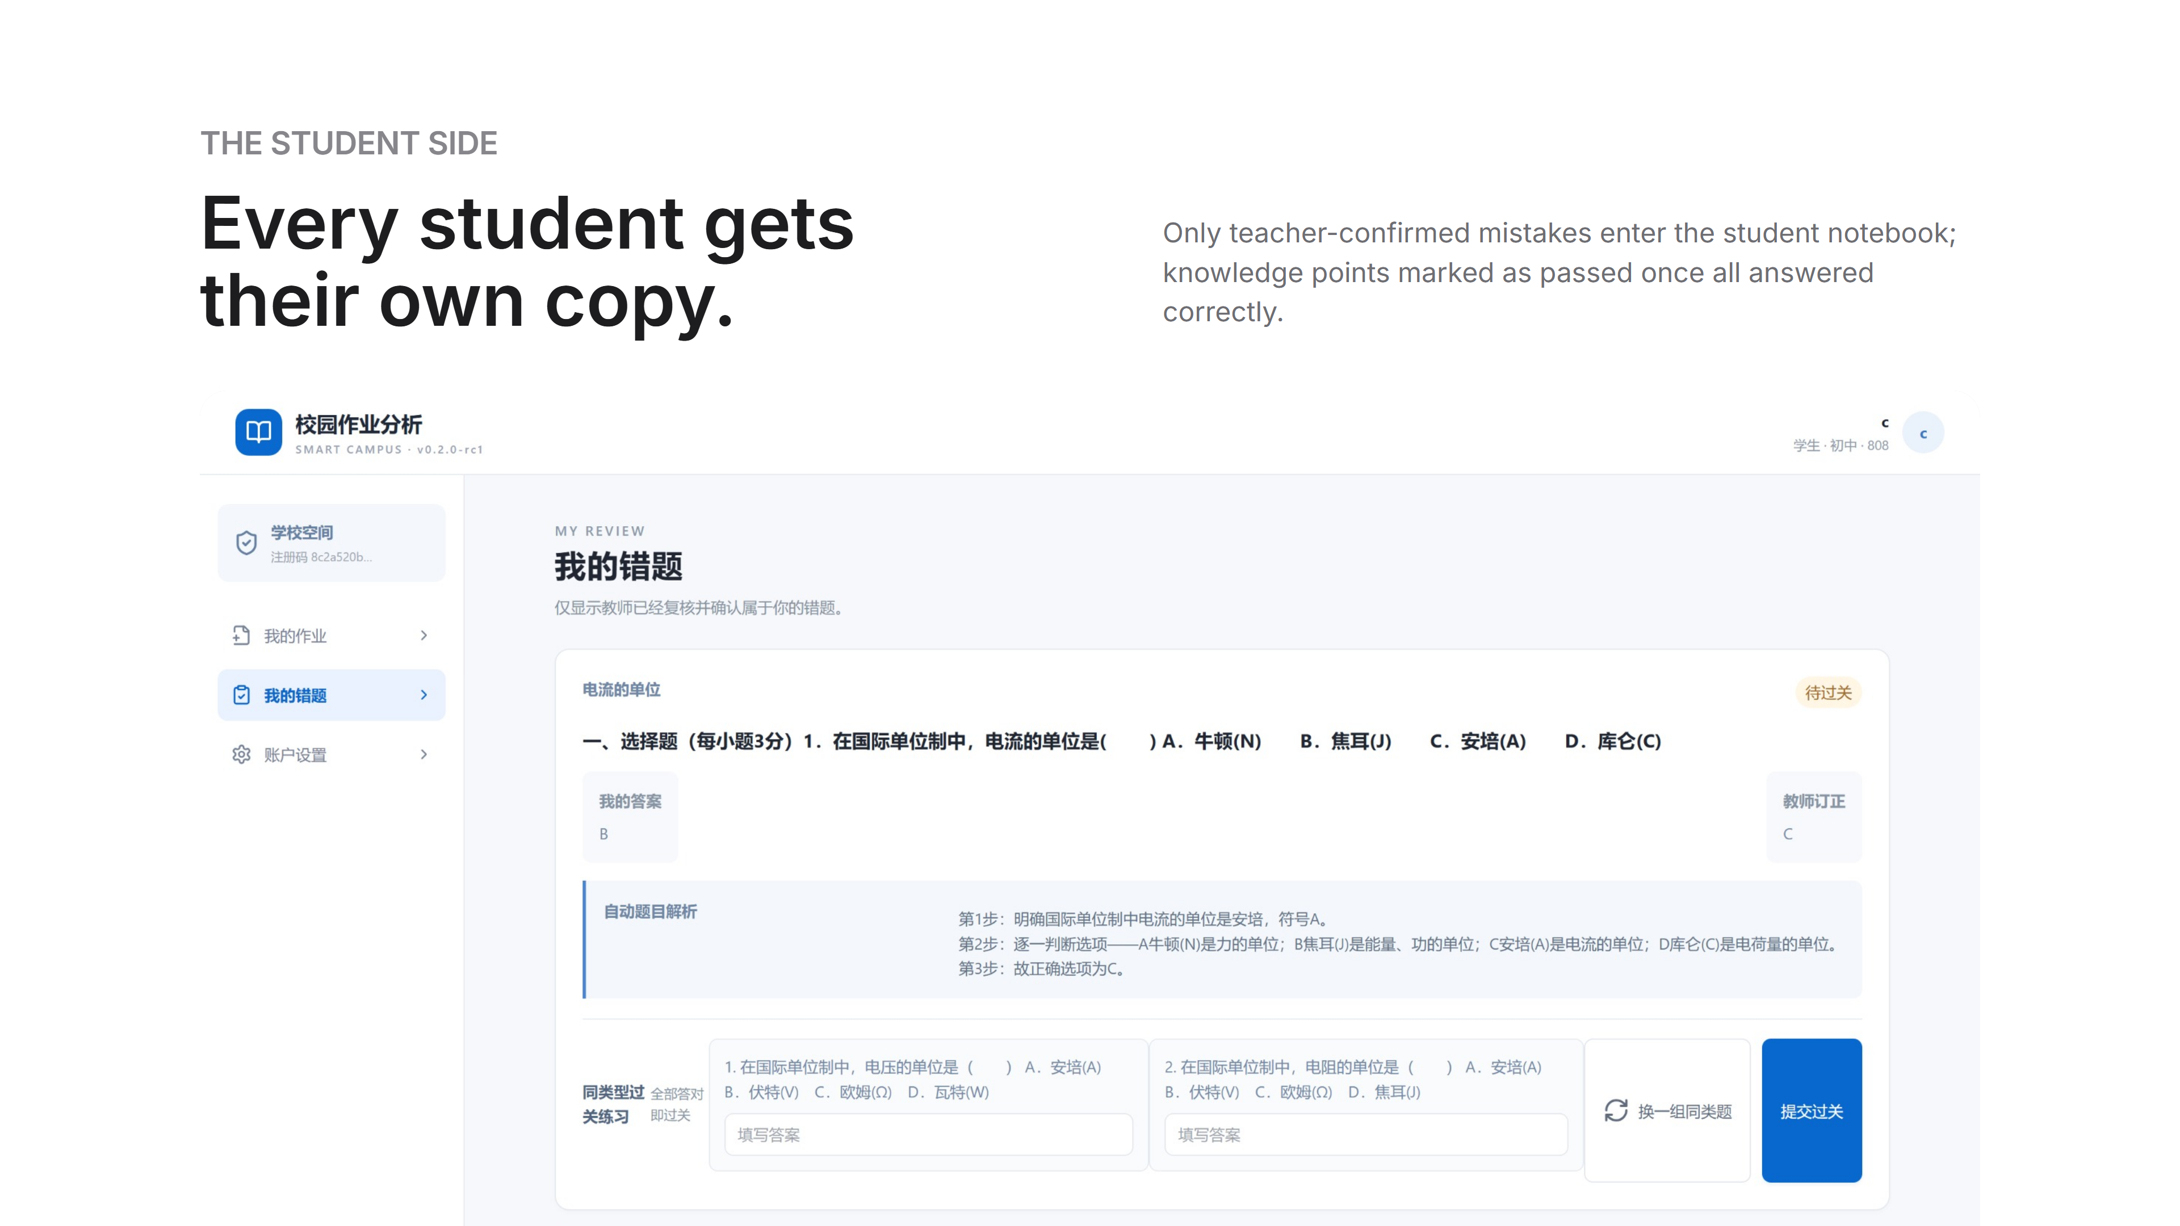
Notes:
The student side does one thing: help students truly master their mistakes. Only teacher-confirmed mistakes enter the student notebook; the system automatically provides step-by-step solutions and similar variant exercises, marking knowledge points as passed once all answered correctly. No more hand-copying mistake notebooks; review becomes targeted.

Slide 12
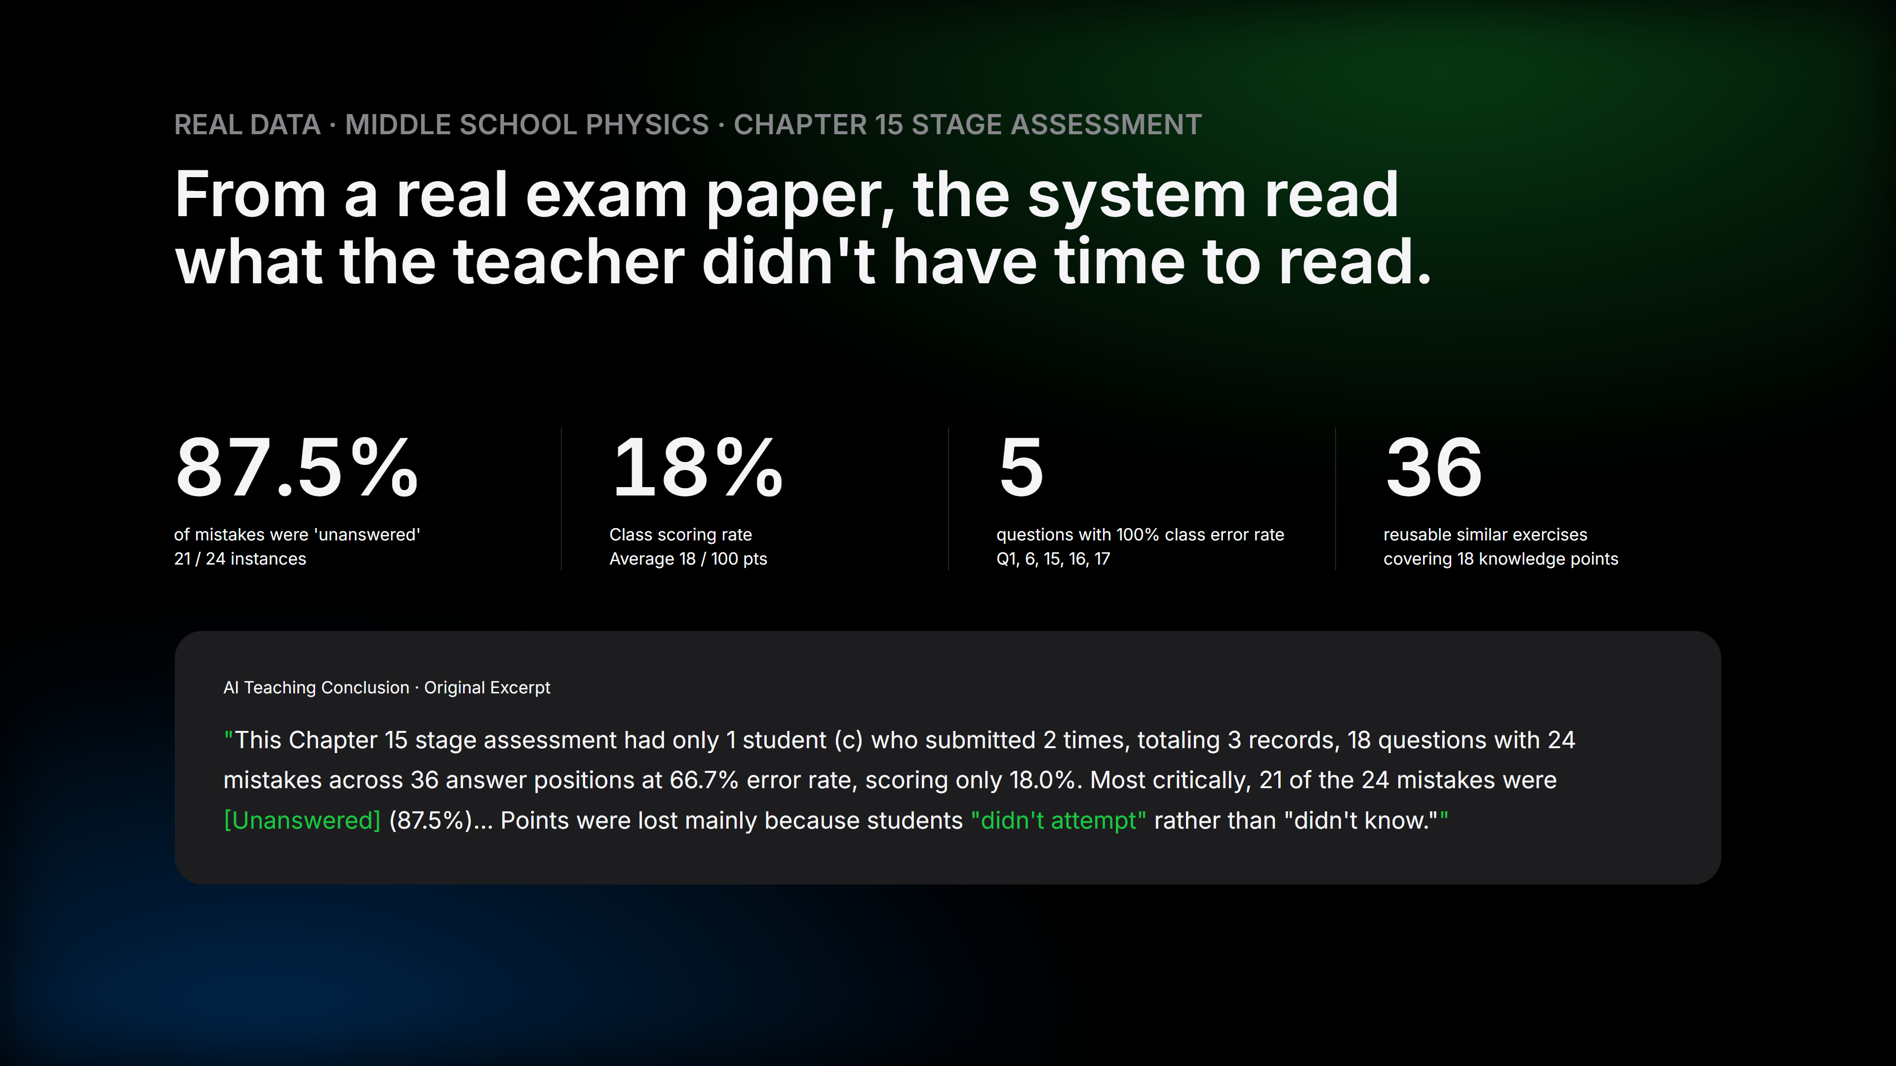
Notes:
Closing with real data. This is a real middle school physics stage assessment from the repo: 18 questions, 3 submissions, 24 reviewed mistakes, class scoring rate 18%. The most valuable finding is what the system discovered on its own — 21 of 24 mistakes were [Unanswered], 87.5%, meaning points were lost because students 'didn't attempt' rather than 'didn't know.' This conclusion directly changes how the lesson should be taught: not more problem-solving, but first addressing 'fear of attempting.'

Slide 13
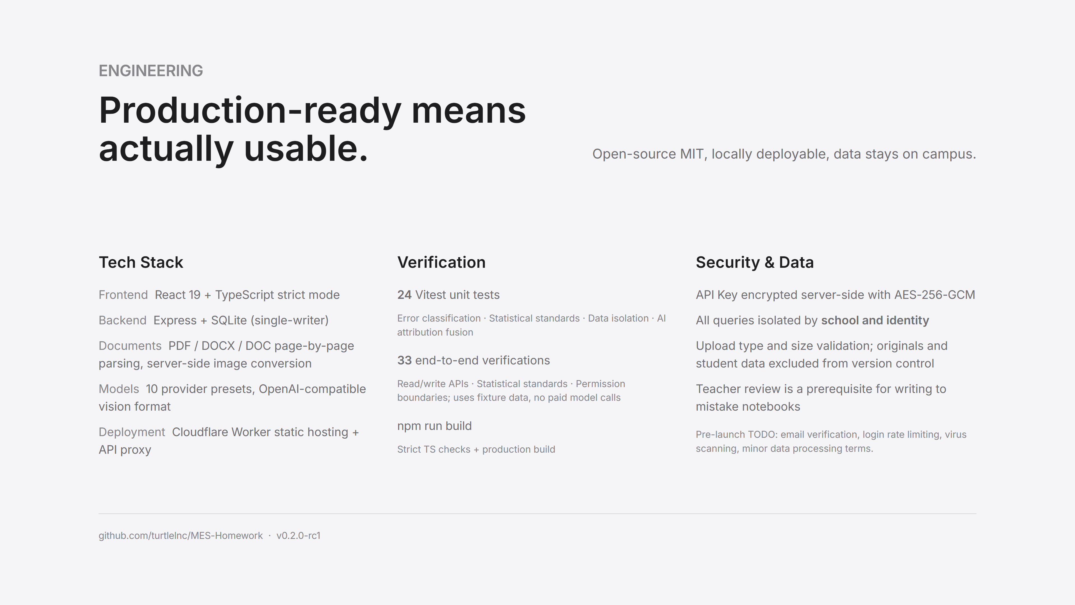
Notes:
Judges often ask 'is it done?' This slide answers: production-ready means actually usable. Standard full-stack tech; quality backed by 24 unit tests plus 33 end-to-end verifications, some specifically testing permission boundaries — students can't read class analytics, school admins can read but can't trigger generation; security-wise, API keys encrypted server-side with AES-256-GCM, all queries isolated by school and identity.

Slide 14
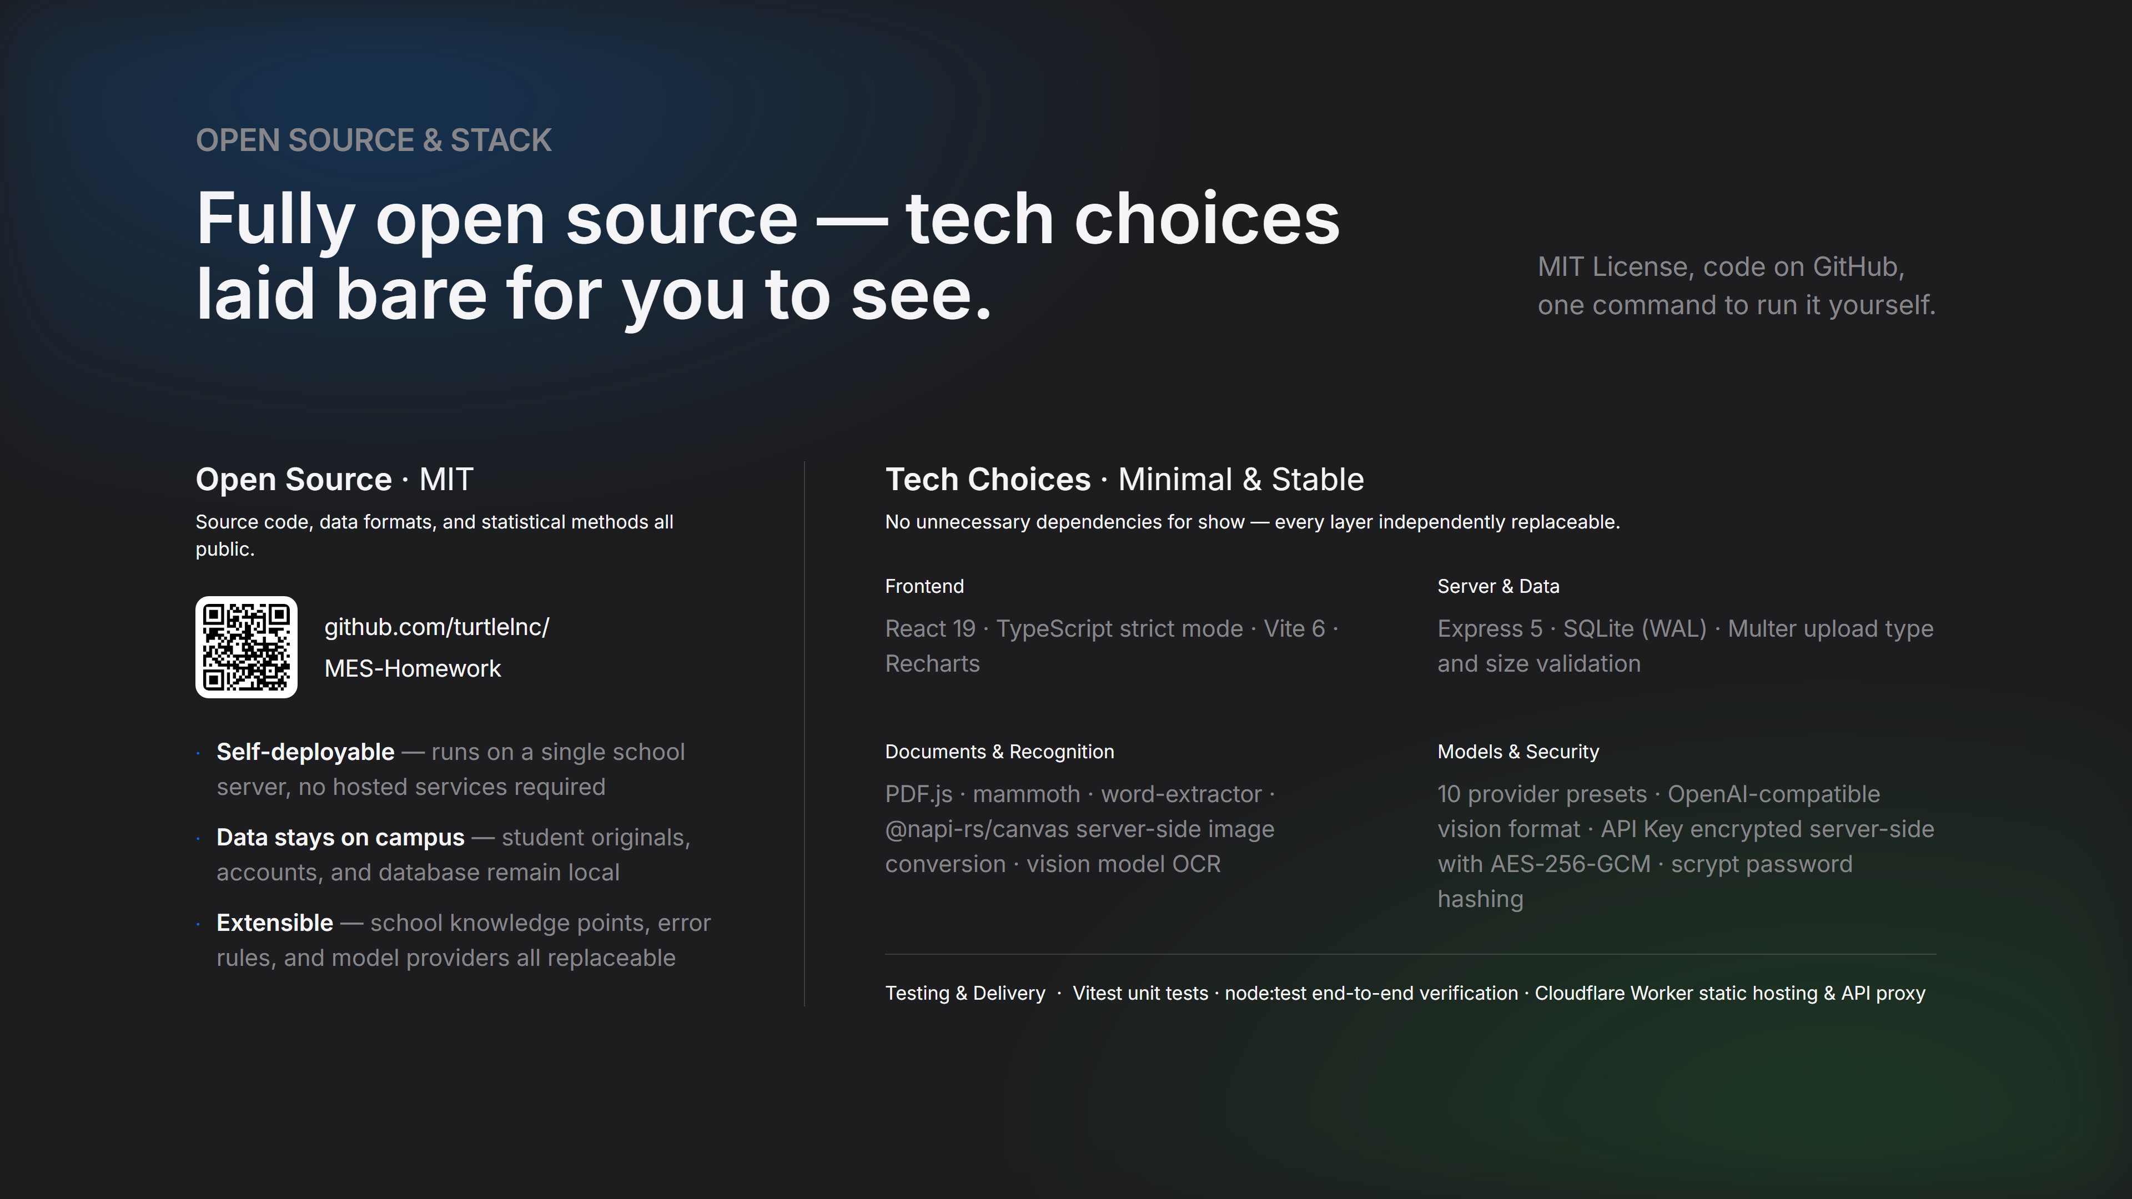
Notes:
The open source and tech slide answers two questions: why trust us, and what did we use. Open source isn't a gesture — it's what educational software should be: schools can self-deploy, data stays on their servers, school-specific knowledge points and error rules are all customizable. Tech choices are deliberately minimal and stable: frontend React 19 + TypeScript strict mode, backend Express + SQLite, document parsing with PDF.js, mammoth, word-extractor, model layer with 10 provider presets plus AES-256-GCM encrypted keys. No unnecessary dependencies for show.

Slide 15
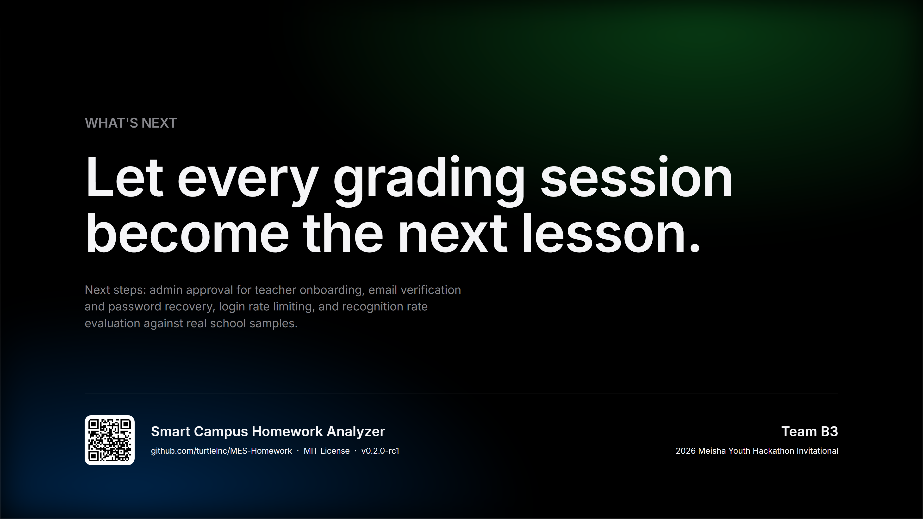
Notes:
Closing. Back to that line: let every grading session become the next lesson. Then leave time for Q&A. If judges only have 30 seconds, say these three things: all numbers come from reviewed data, AI only transcribes; teachers receive a lesson plan they can use immediately; everything is open source, locally deployable, data stays on campus.

